Slide 1
BCCA figures
March 13 2025

Slide 2
Data % to report
X2.1.Flow.Type n prop
<chr> <int> <dbl>
1 Biotic 113 0.551
2 Human movement 21 0.102
3 Physical 38 0.185
4 Sociocultural 33 0.161

Slide 3
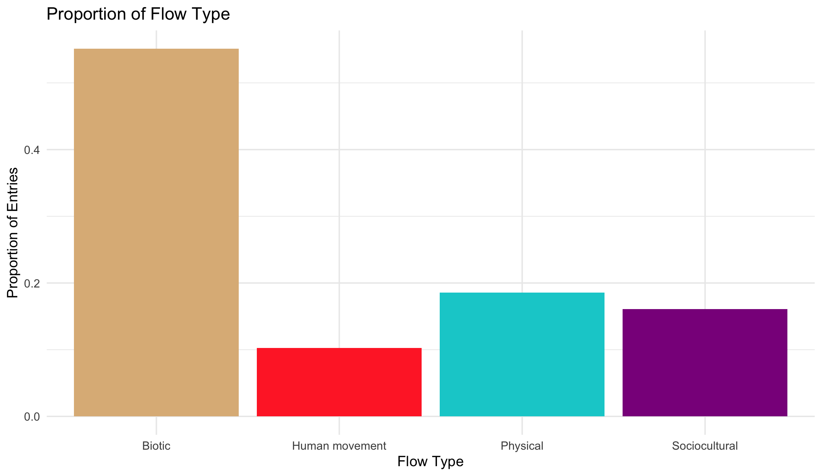

Slide 4
Multiple flows
Another.Flow. n prop
1 No 168 0.820
2 Yes 37 0.180

Slide 5
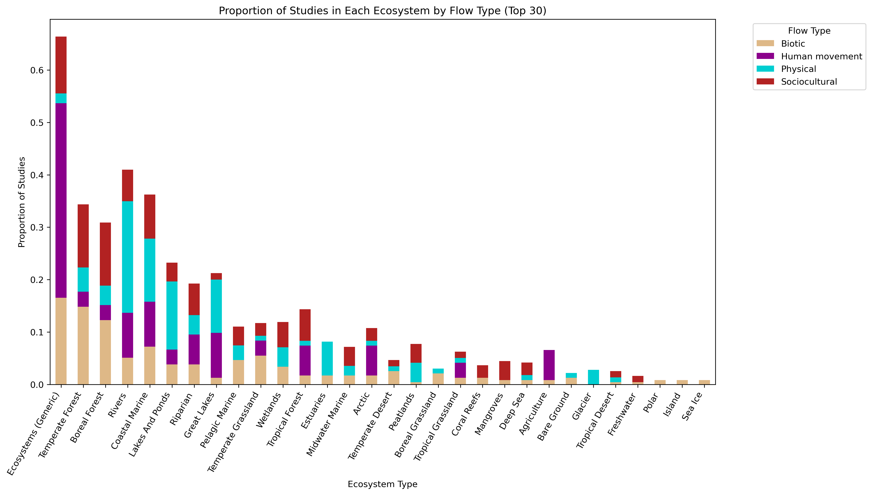
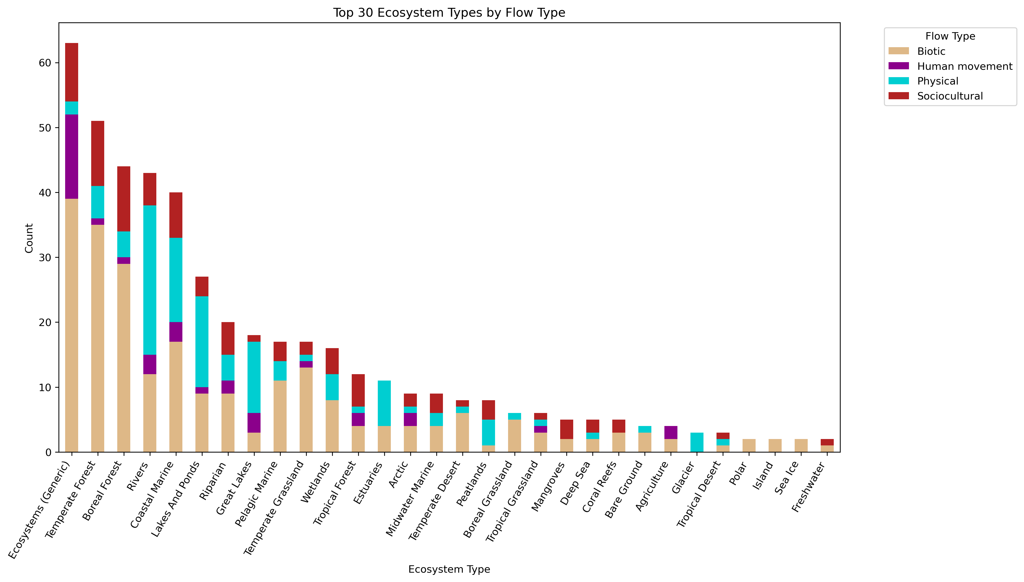

Slide 6
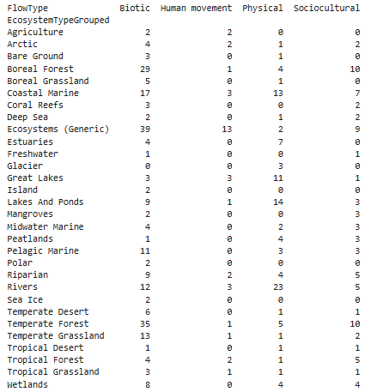
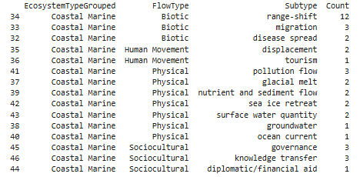

Slide 8
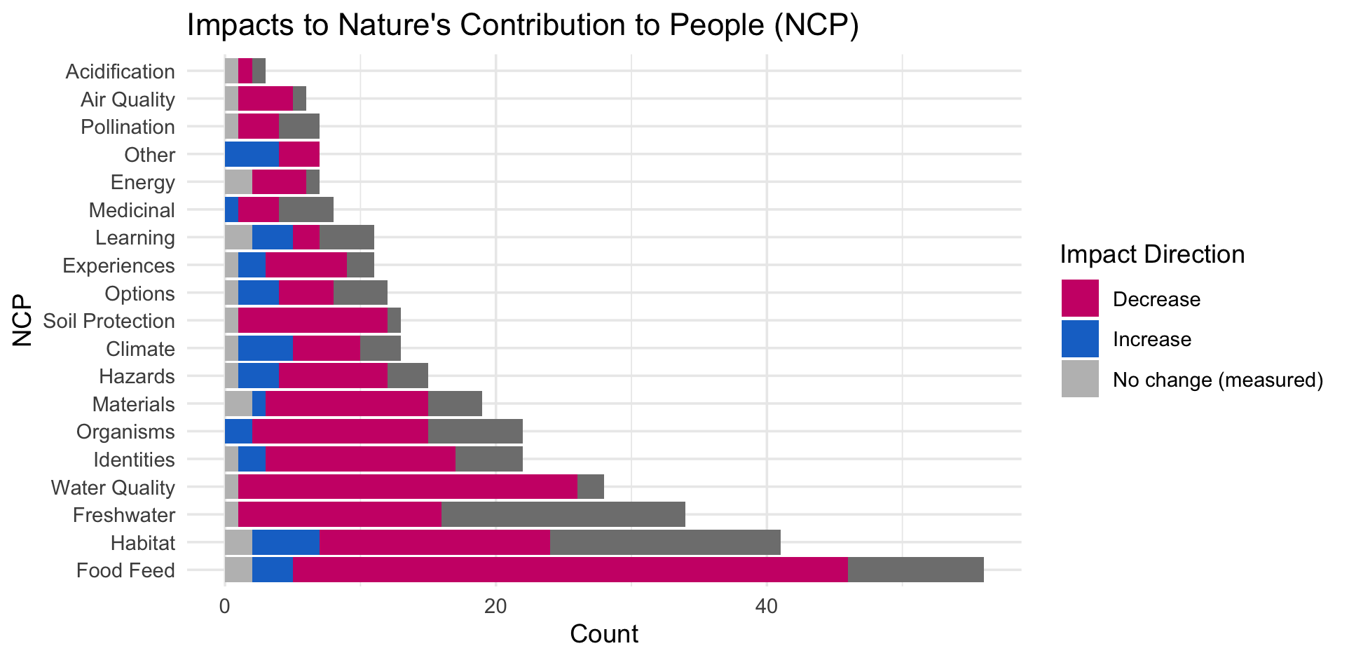

Slide 10
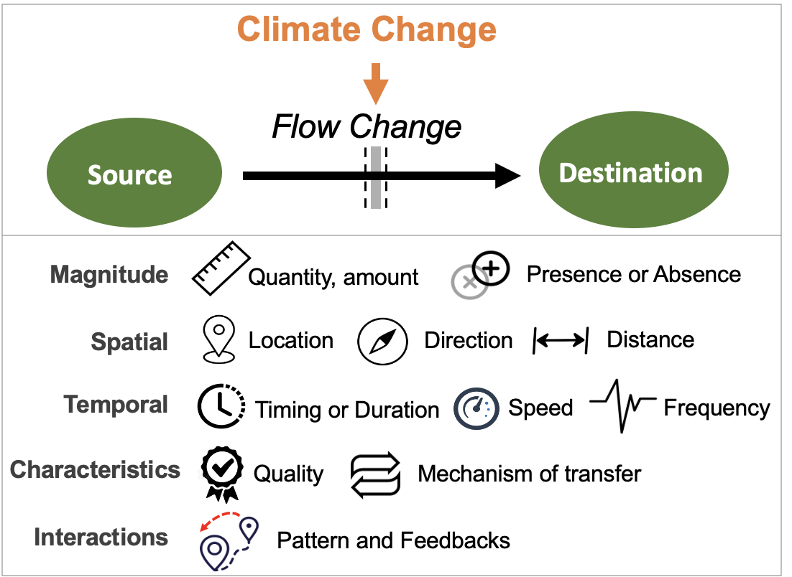
Most common paths
Climate change →

Slide 11
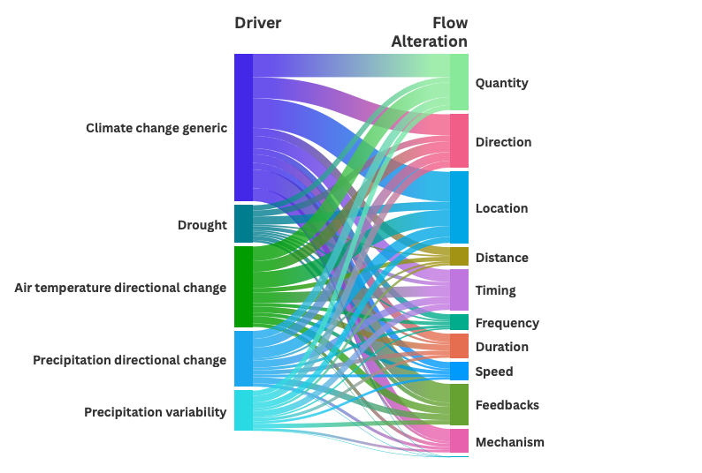

Slide 12
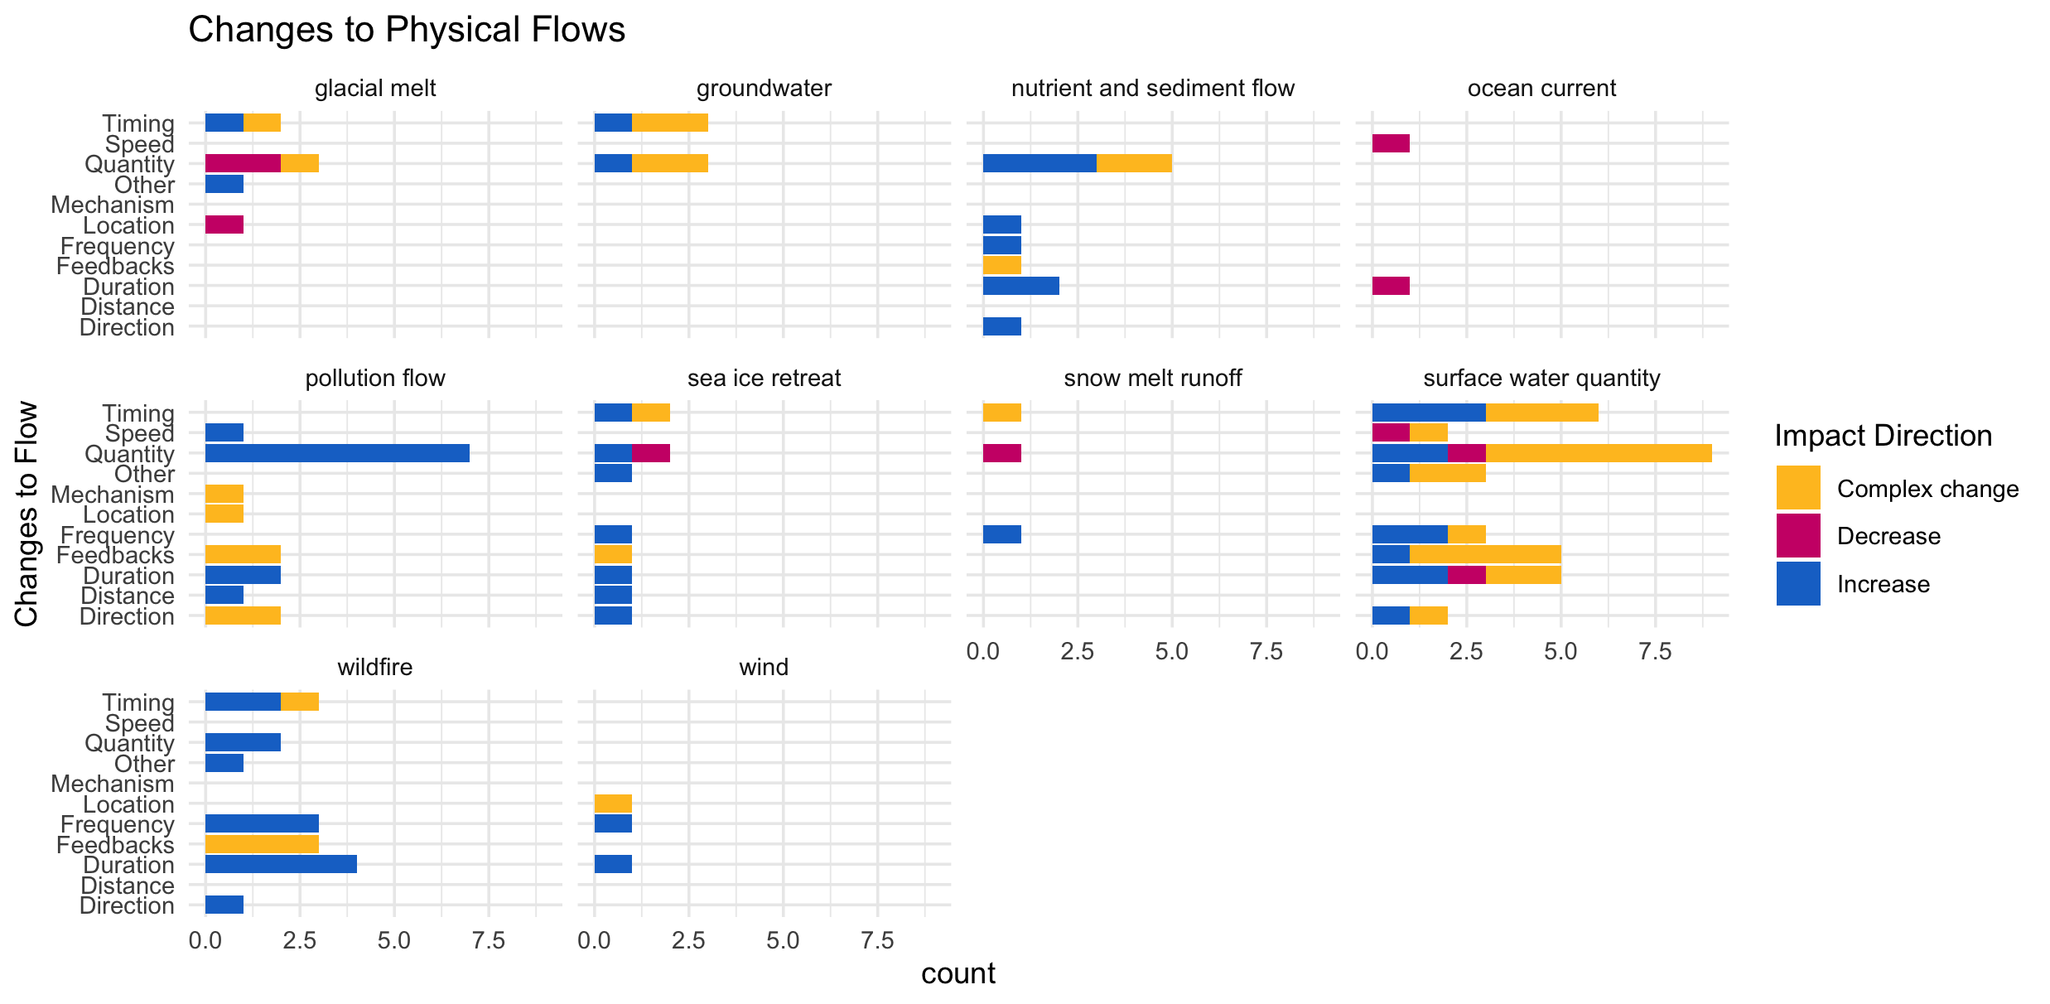

Slide 13
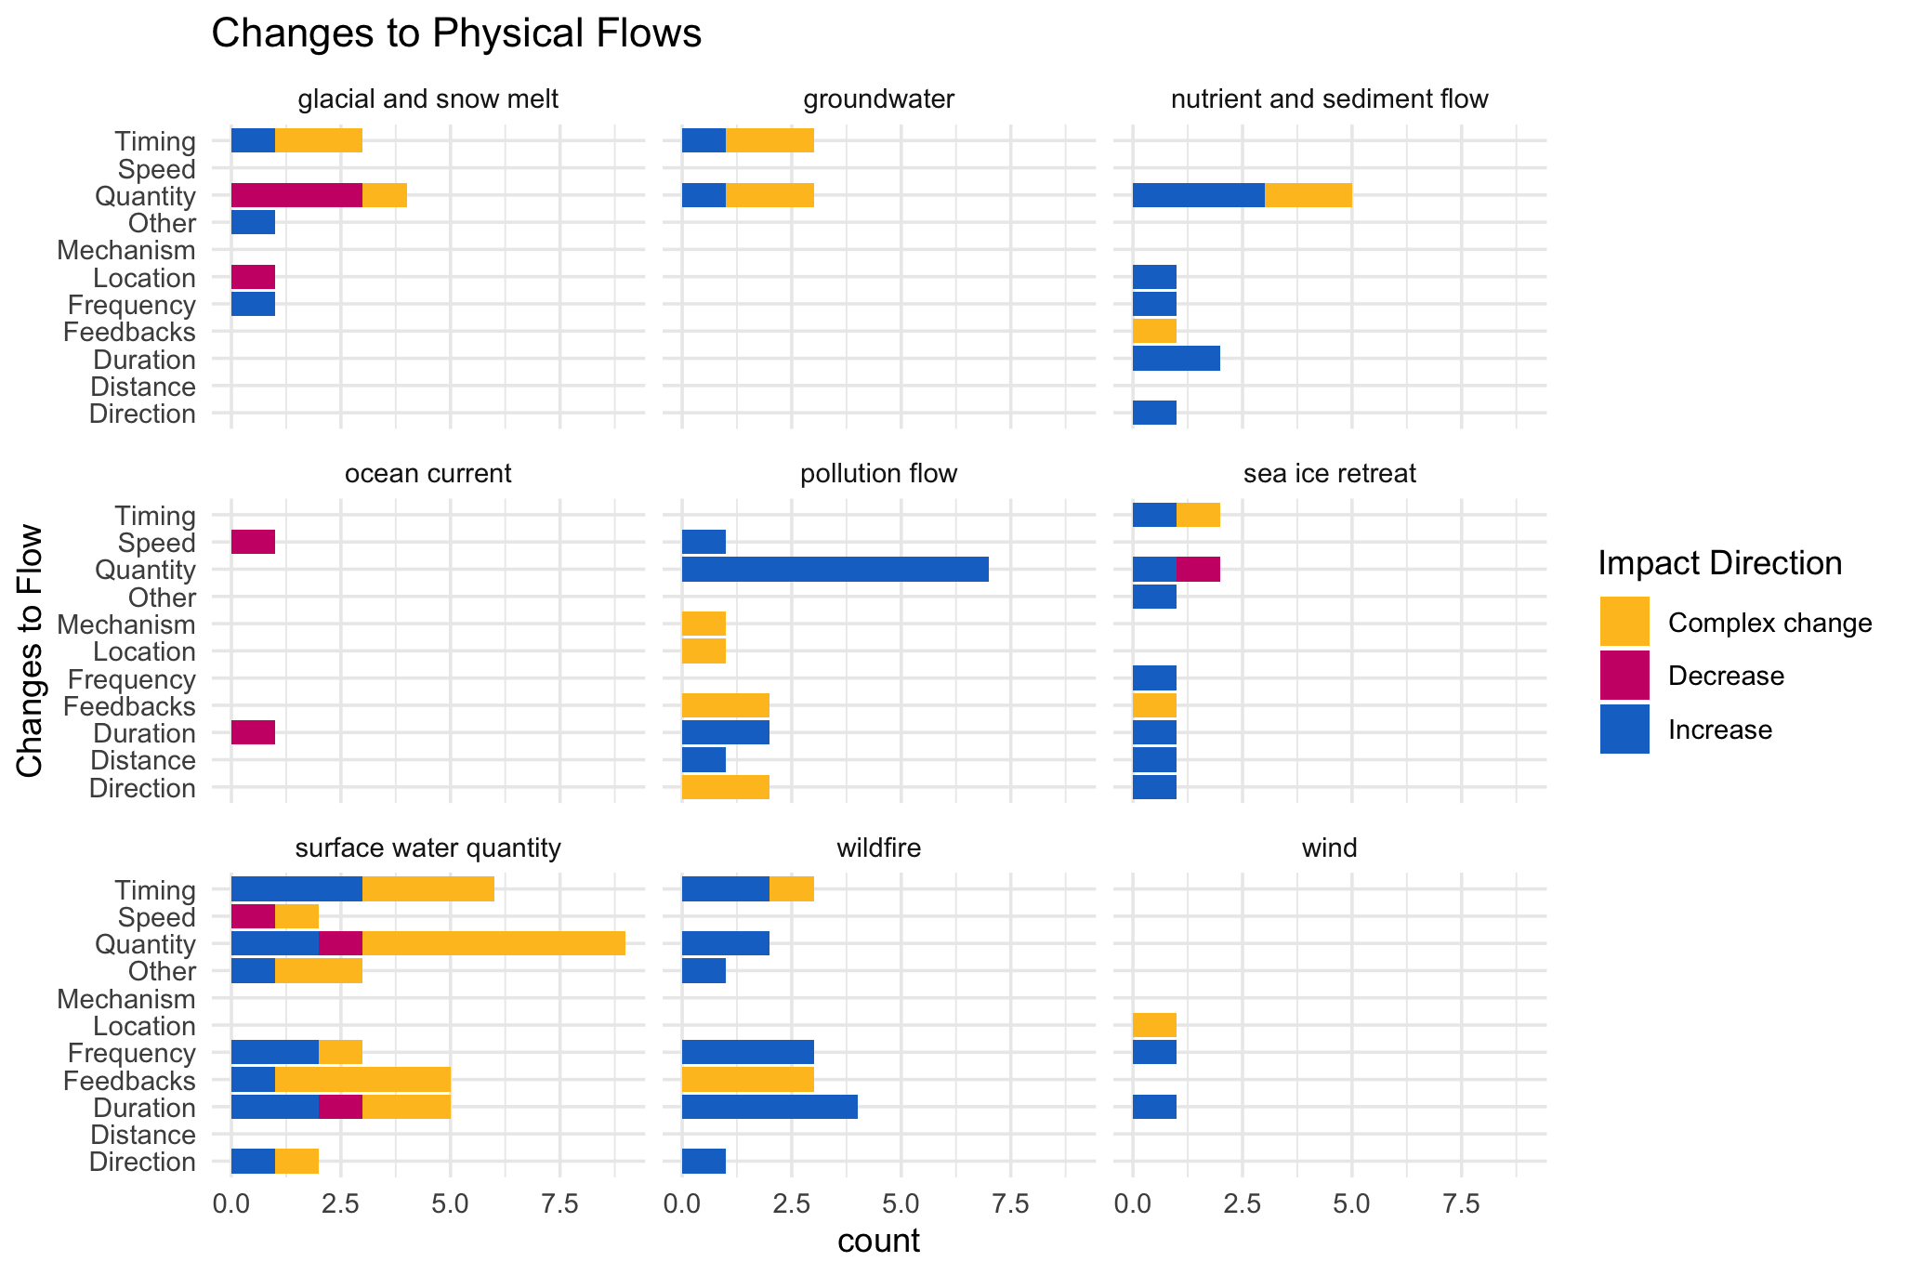

Slide 14
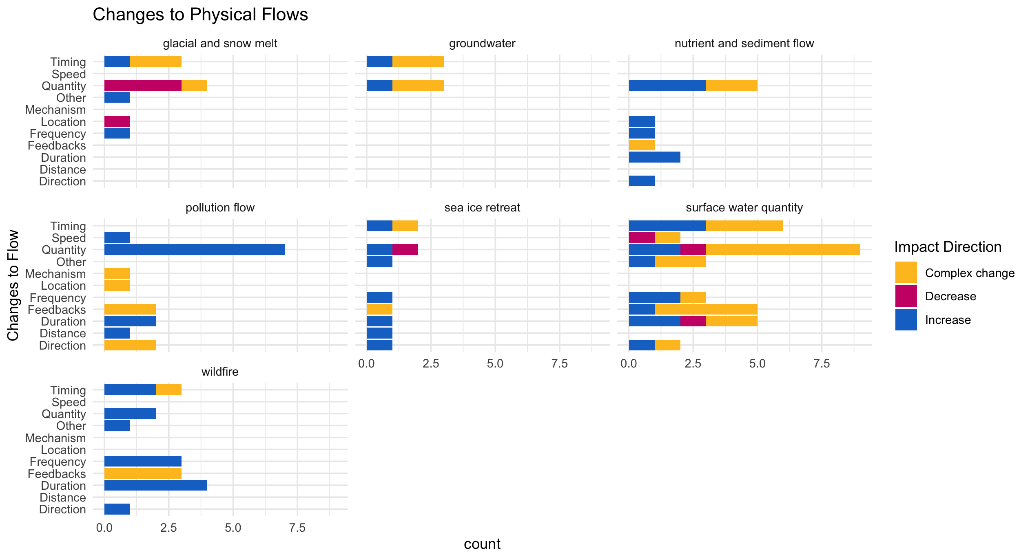

Slide 15
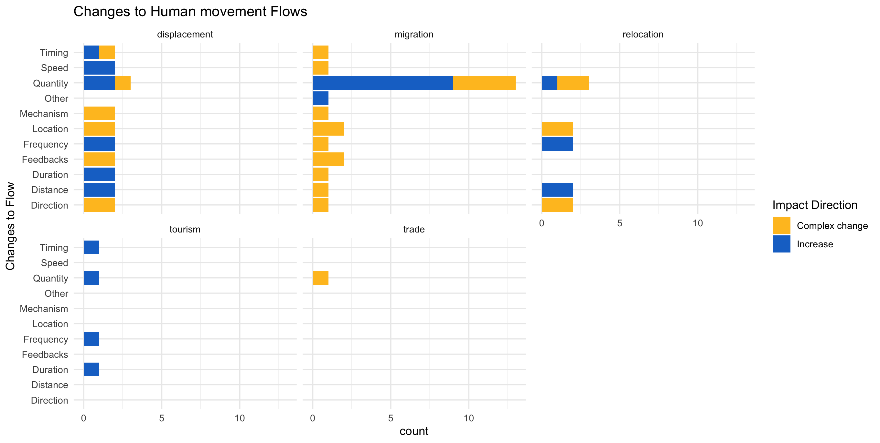

Slide 16
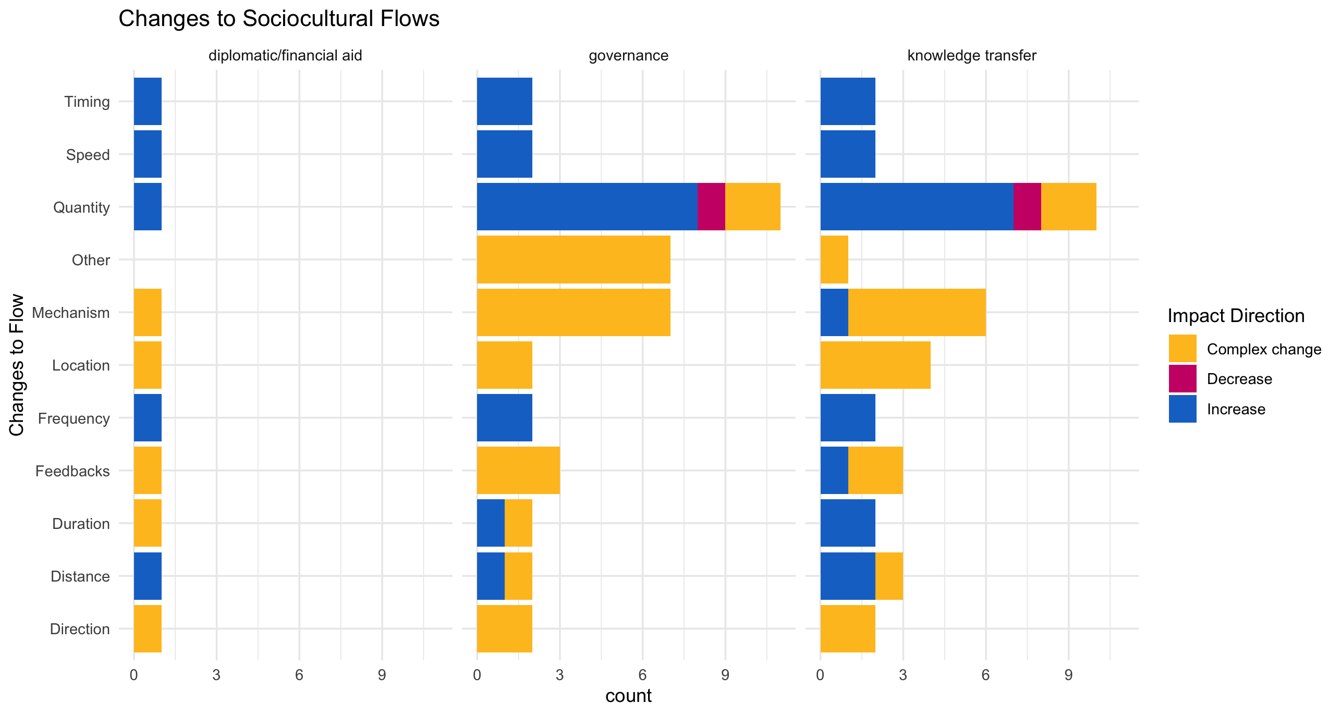

Slide 17
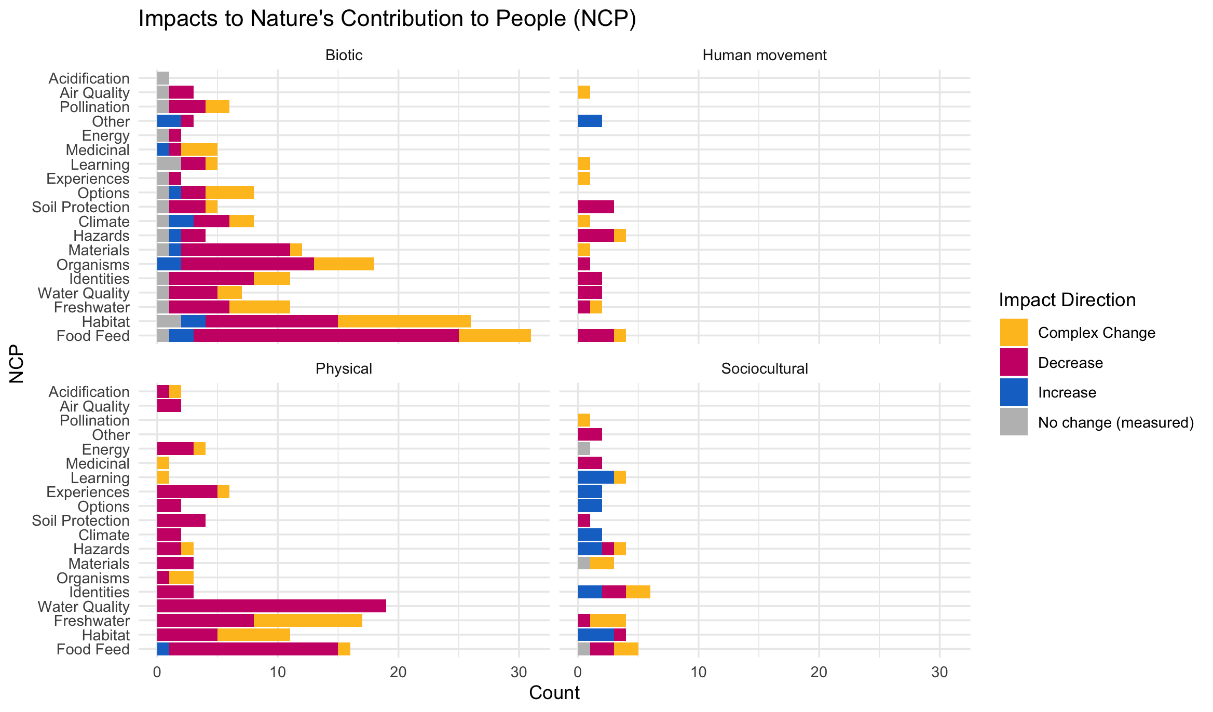

Slide 18
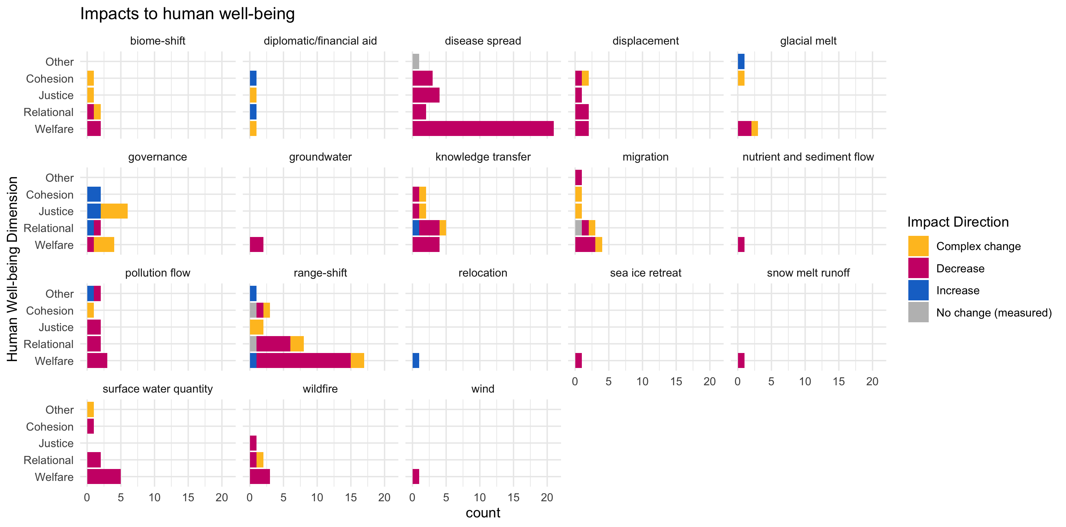

Slide 19
OLDER:

Slide 21
At least 5 entries – top – to get stats on % of entries or papers on these:

Slide 22
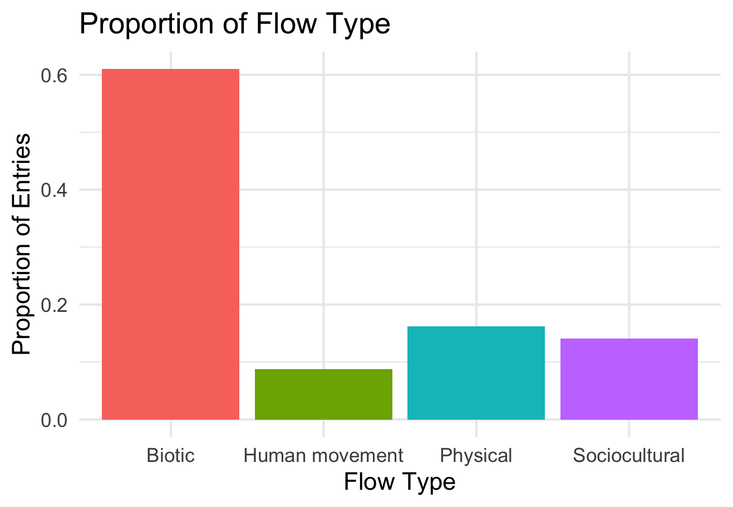

Slide 23
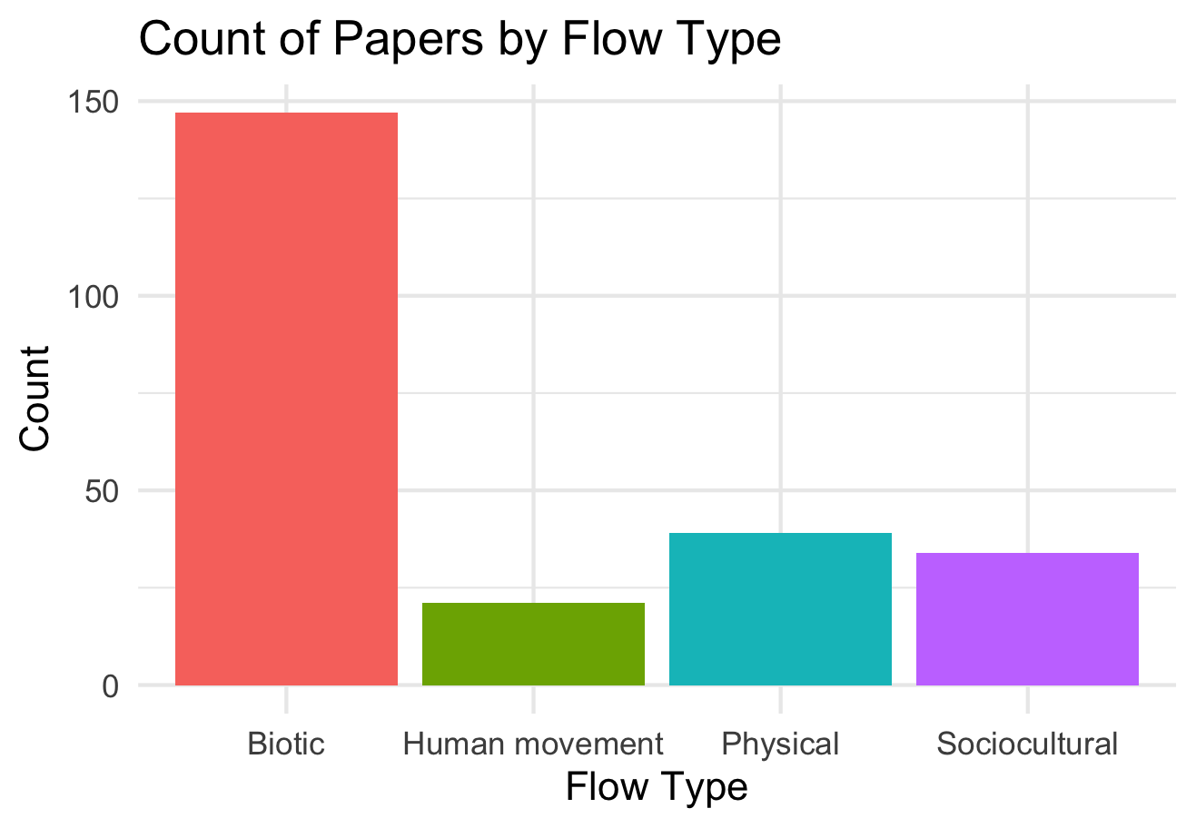

Slide 24
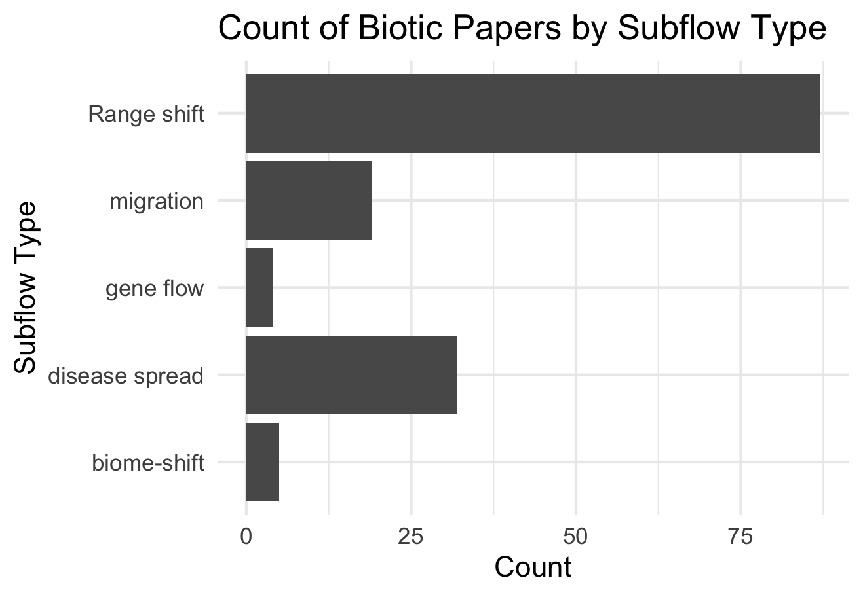

Slide 25
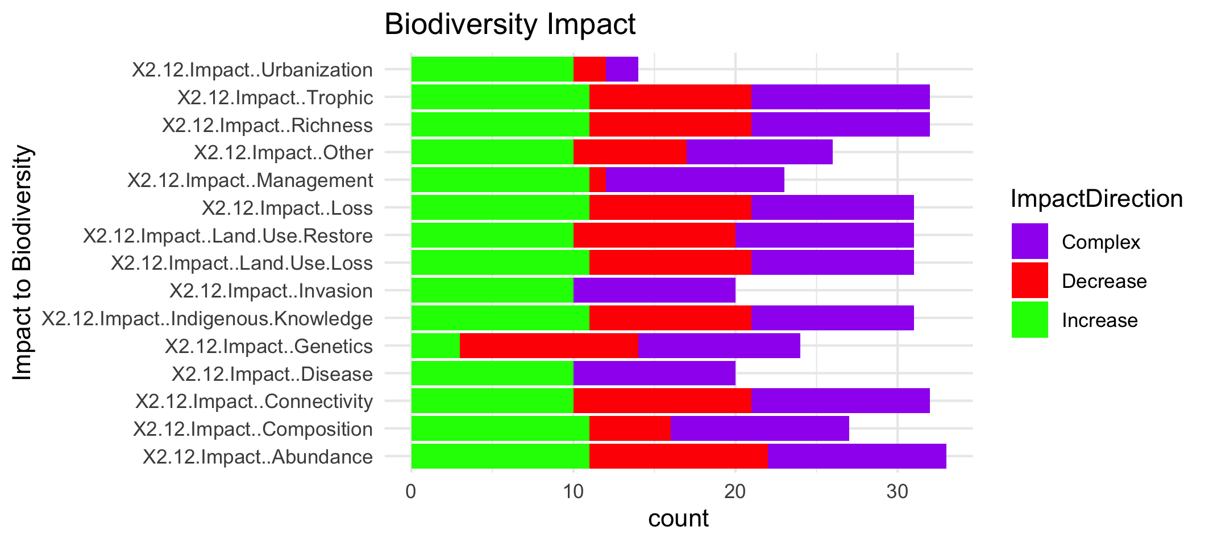

Slide 27
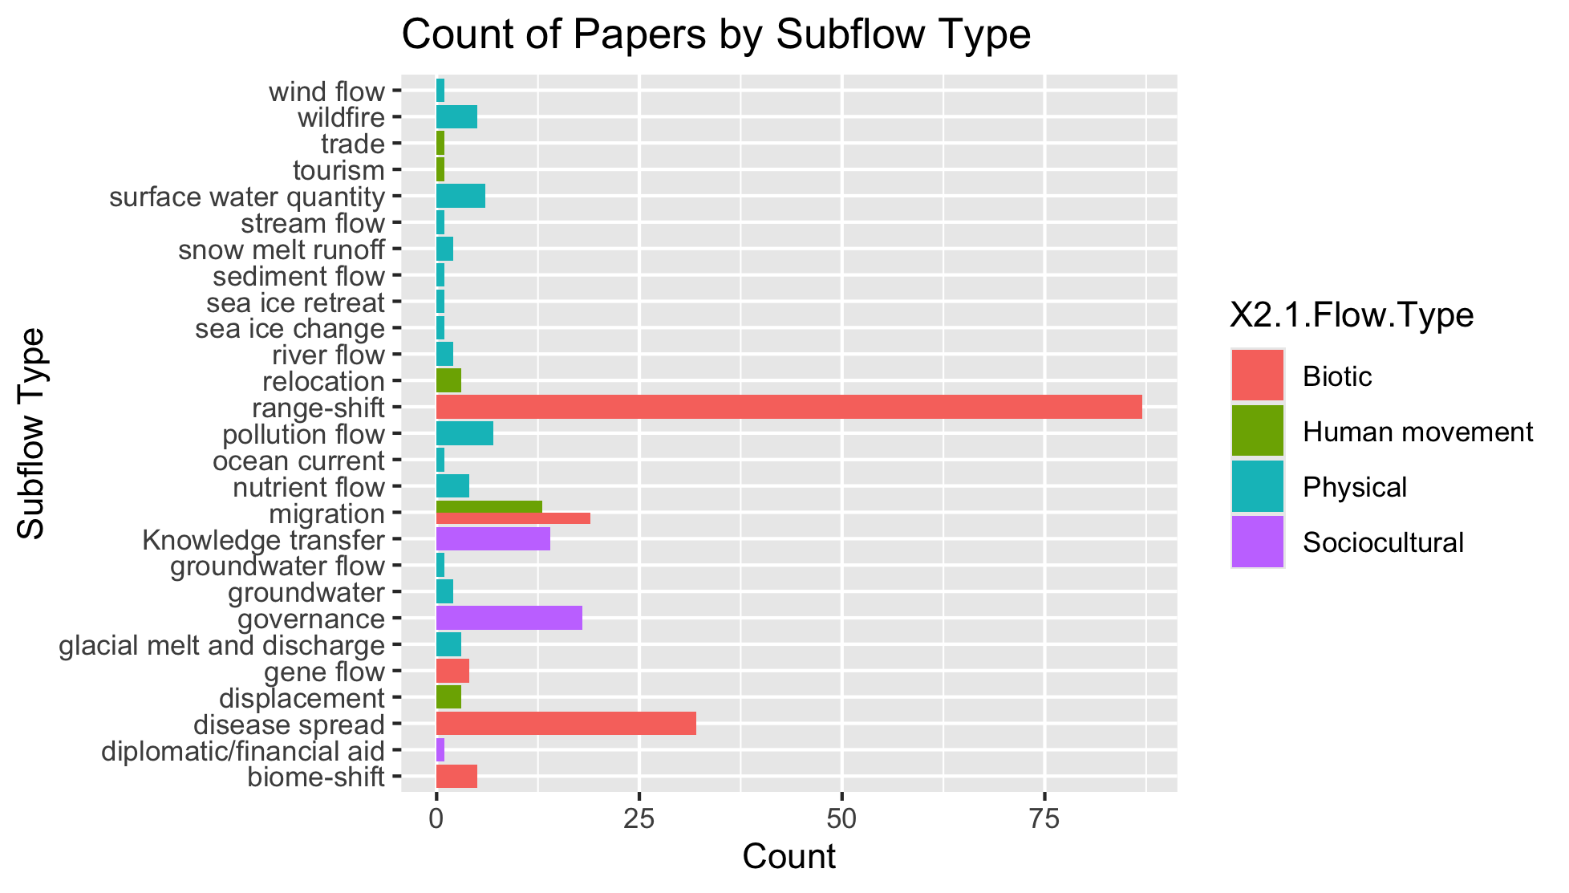
To group physical flow papers

Slide 28
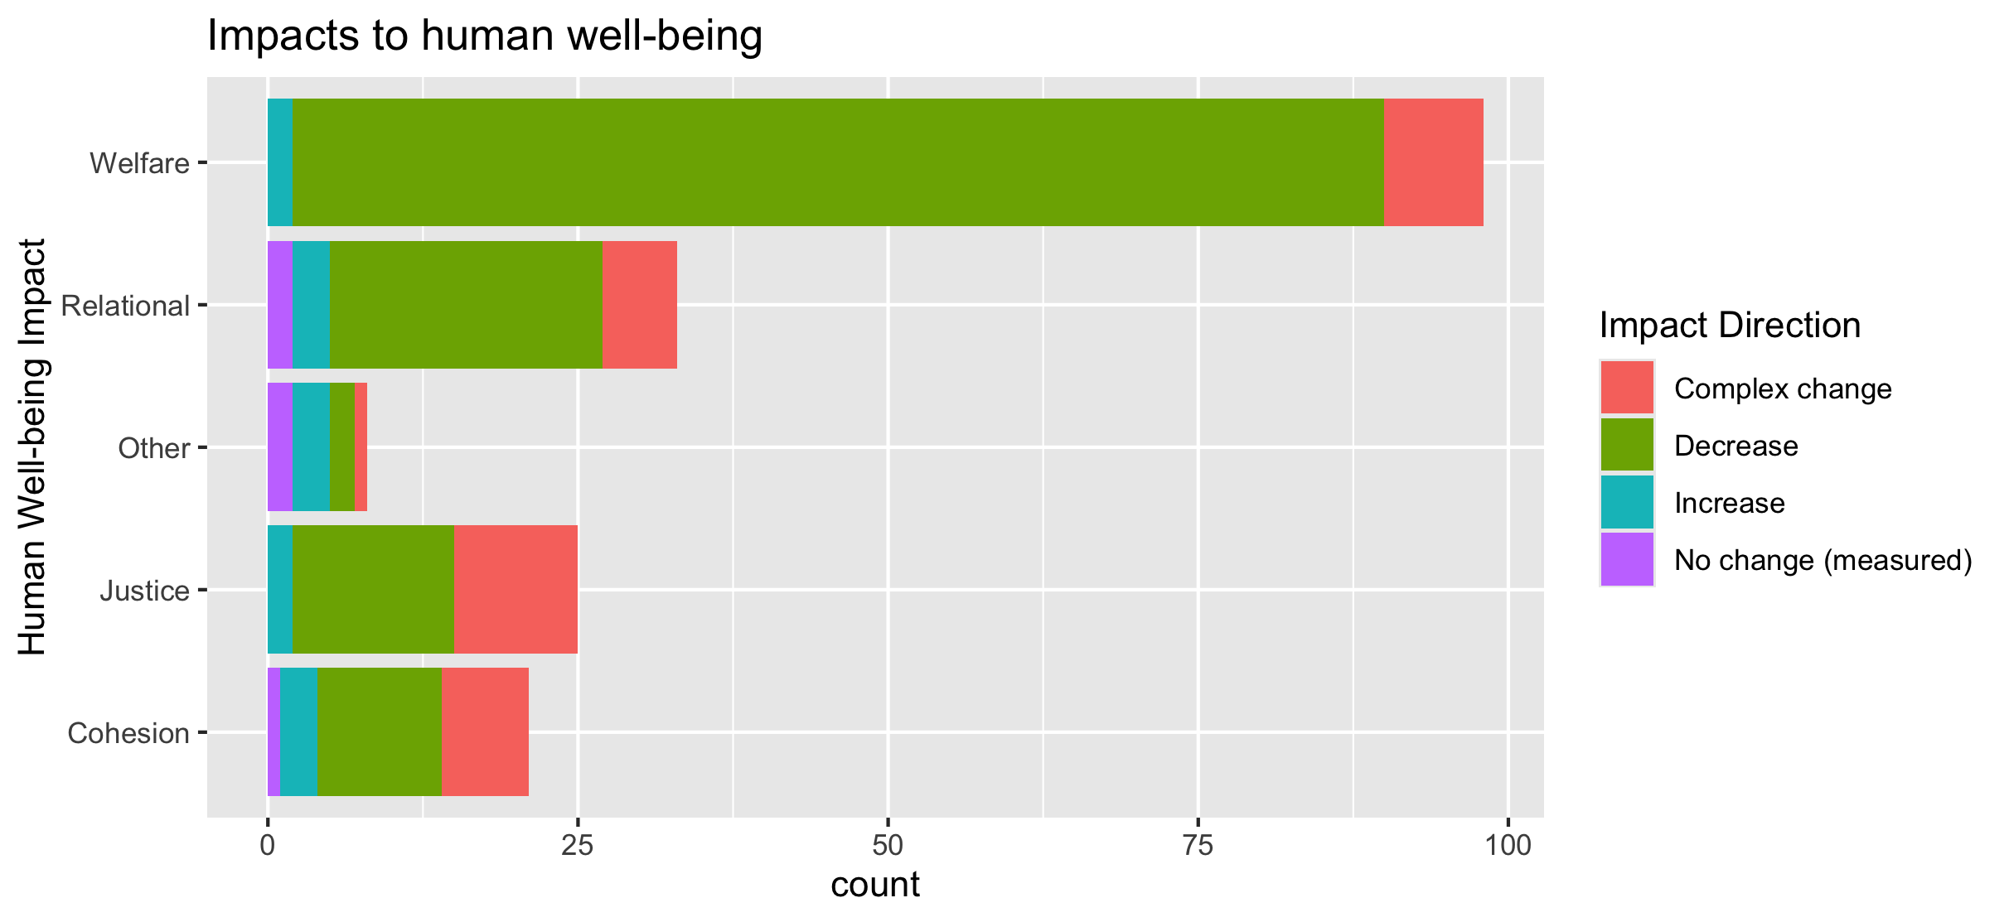
To align direction colors with final color pallet

Slide 29
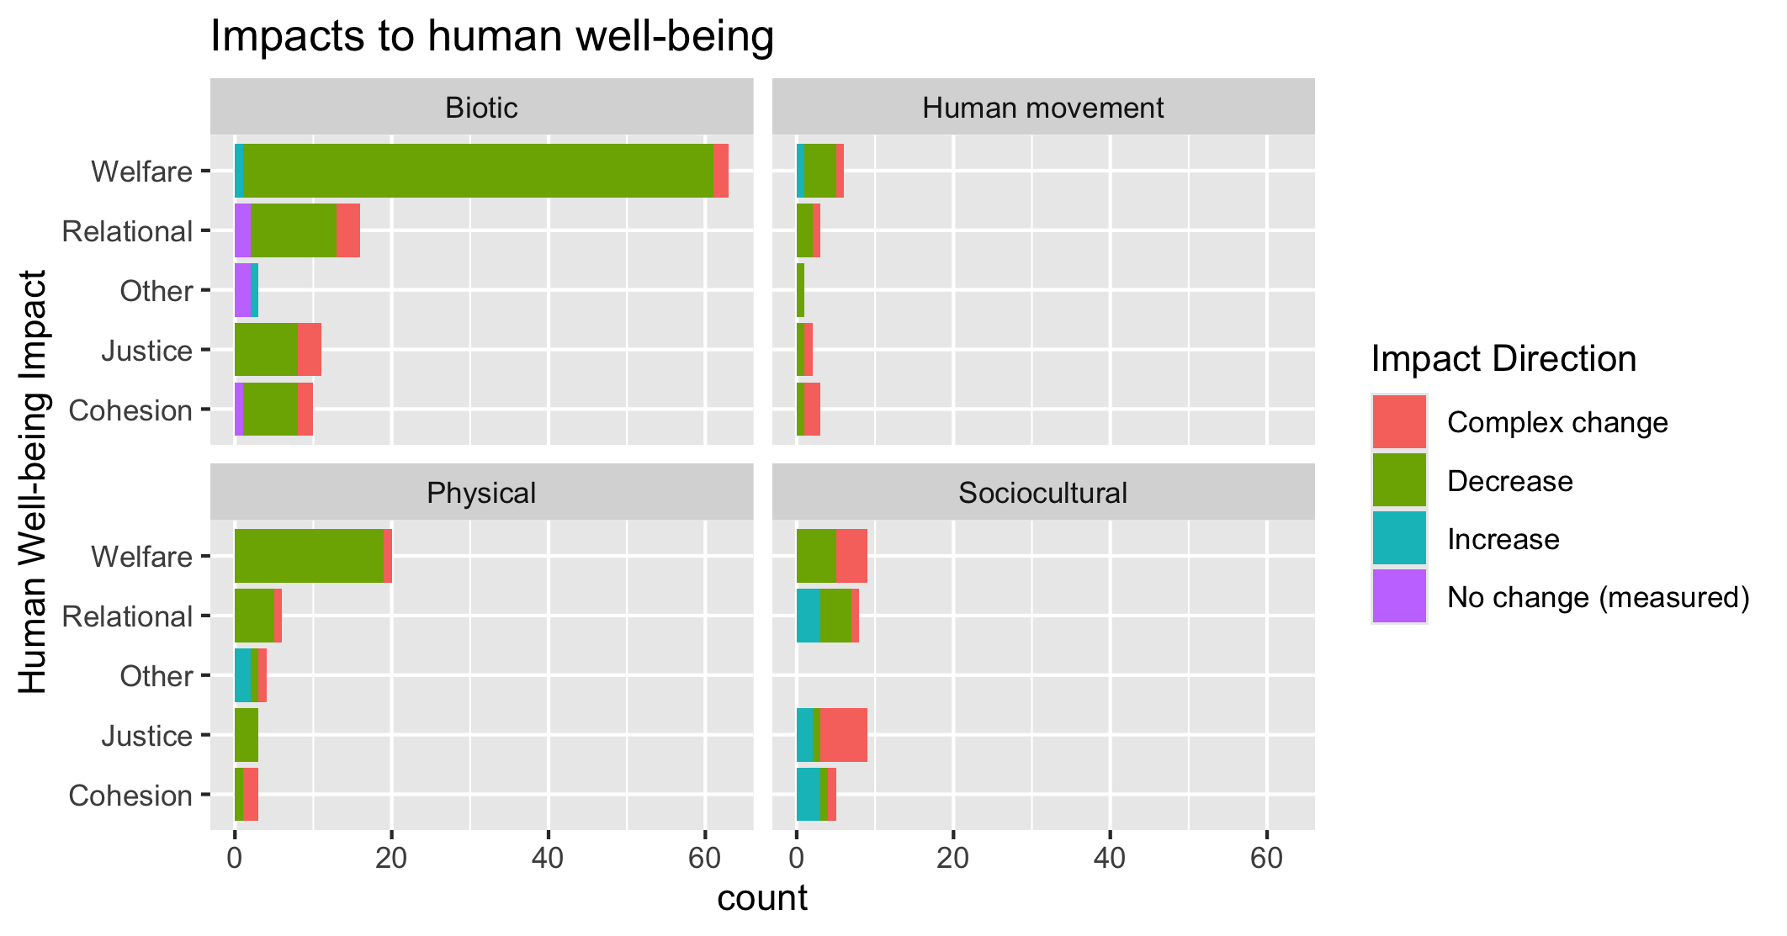
To align direction colors with final color pallet

Slide 30
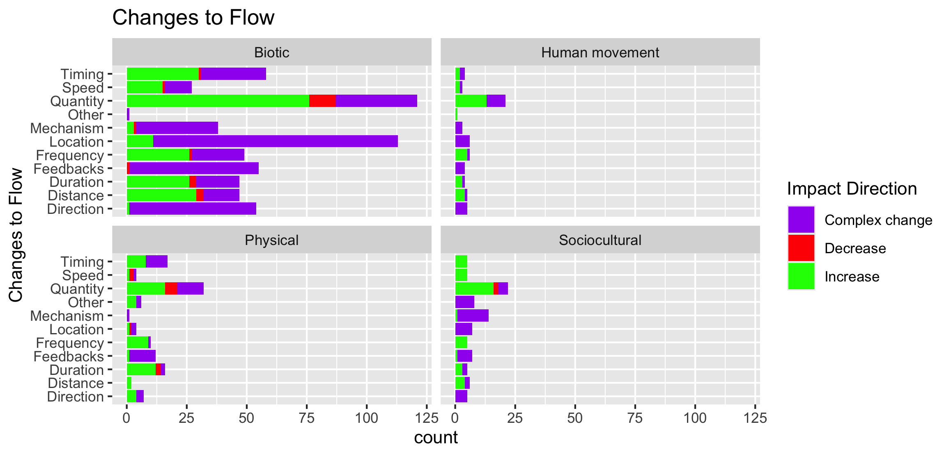

Slide 31
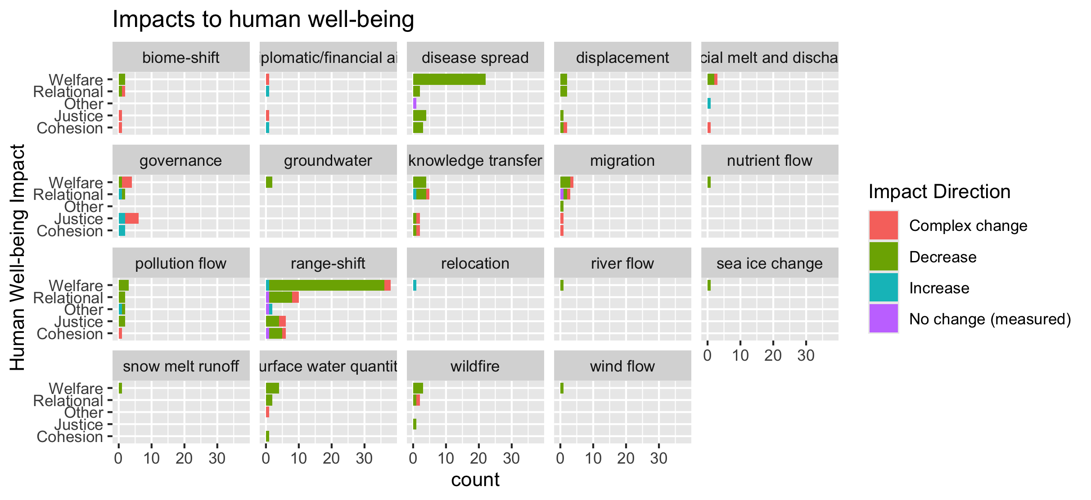
To group physical flow papers

Slide 32
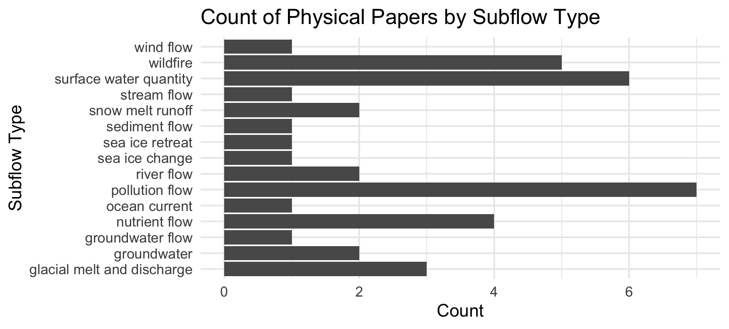

Slide 33
Feb 23 2025

Slide 34
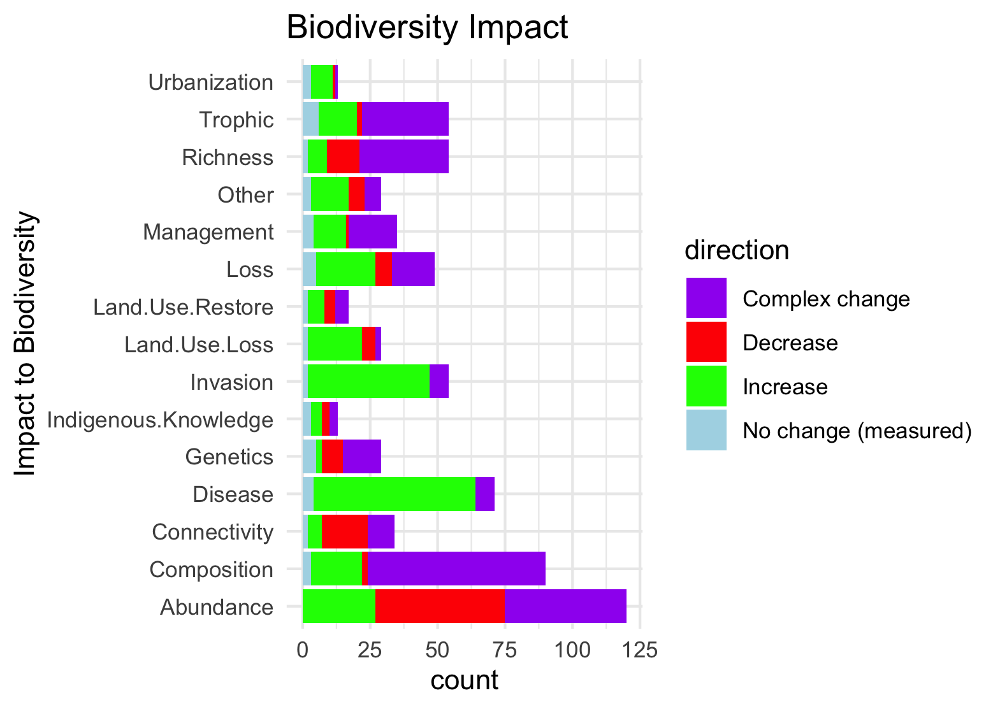
Needs to be grouped by what is good and what is bad to see increase in:

Slide 35
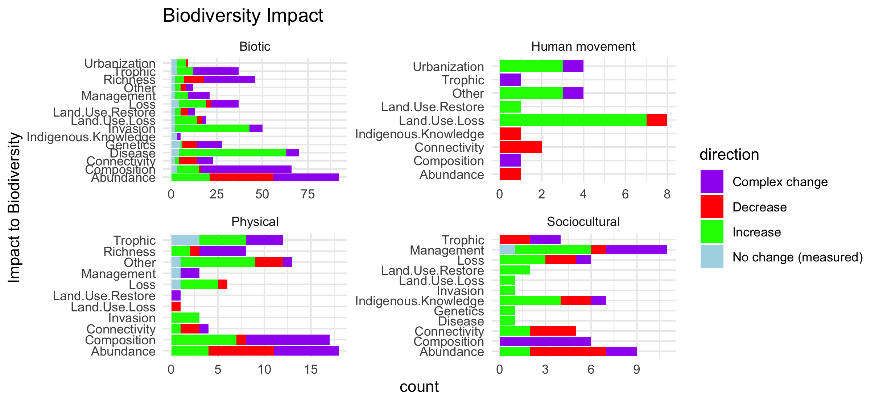
Scale free on the facet (diff x axis)

Slide 36
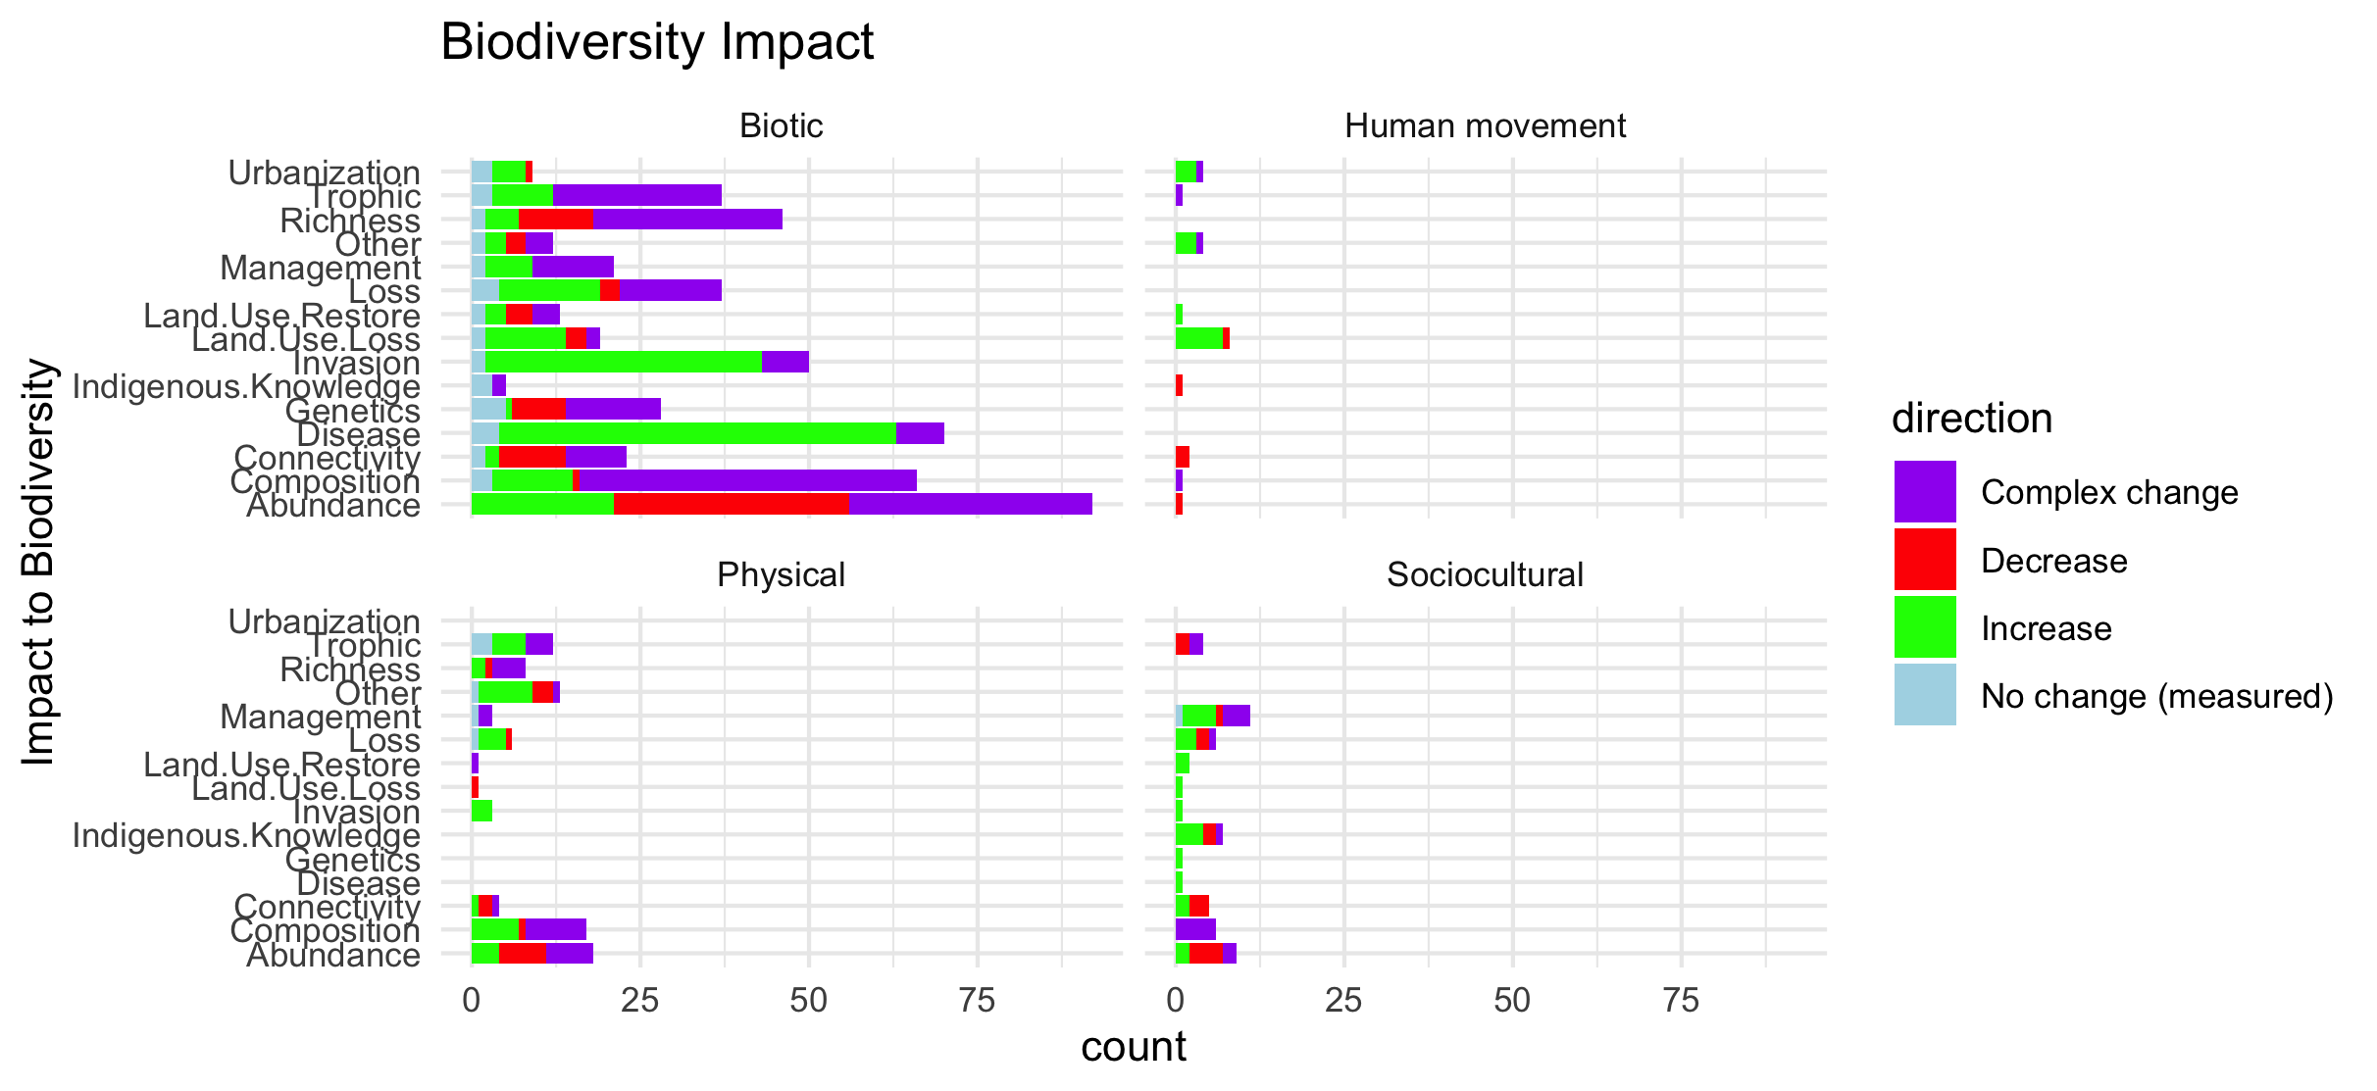
Scale fixed on the facet (same x axis)

Slide 37
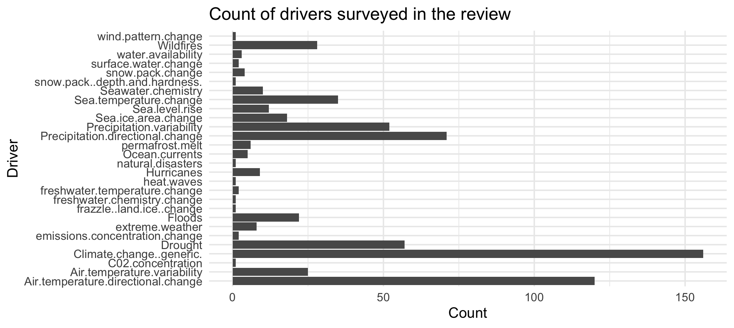

Slide 38
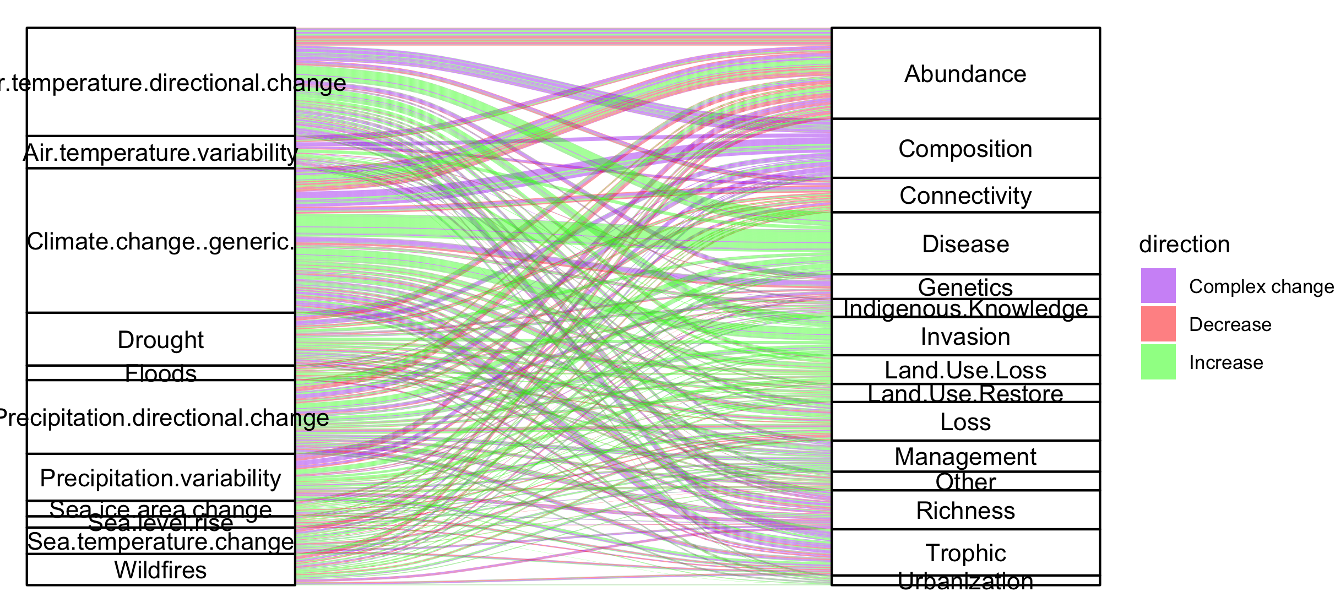
Colleen: see note isn the code – we could group spme of the drivers (hurricaines, extreme weather, ands ome of the ice ones). This still doesnt take into account if changes arw good or bad though and might just be too busy.

Slide 39
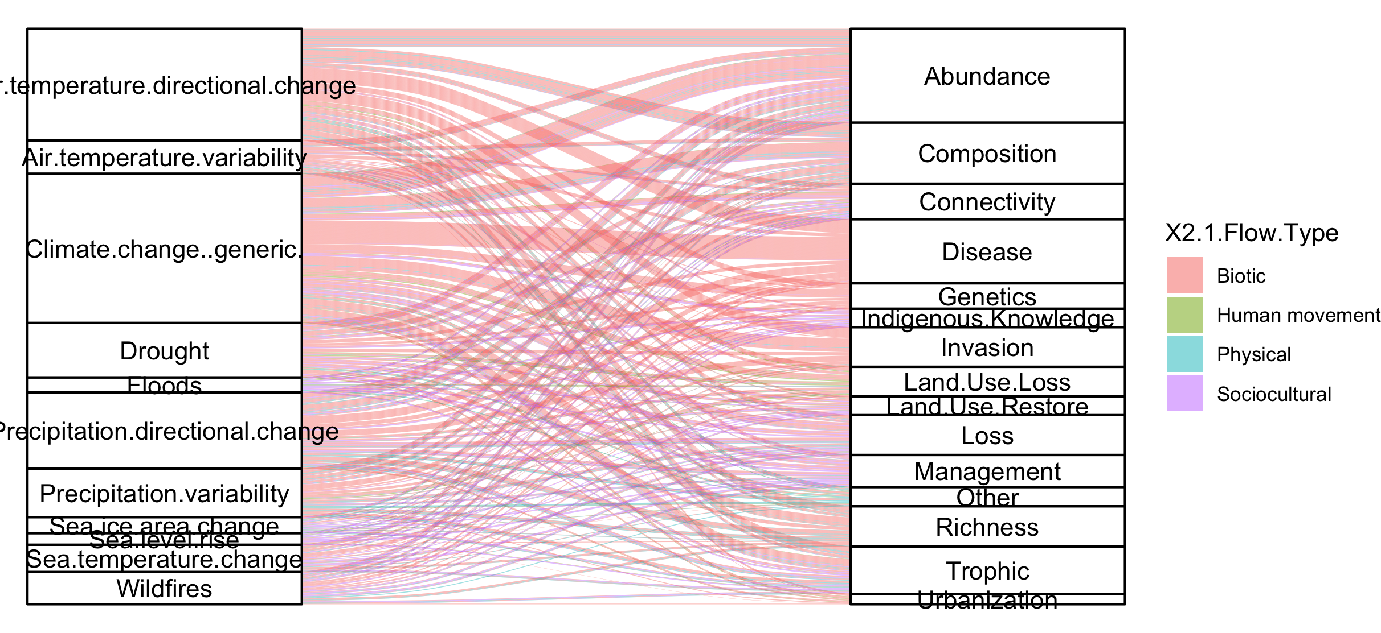
#not that informative because so many more of the papers are biotic

Slide 40
NCPs

Slide 41
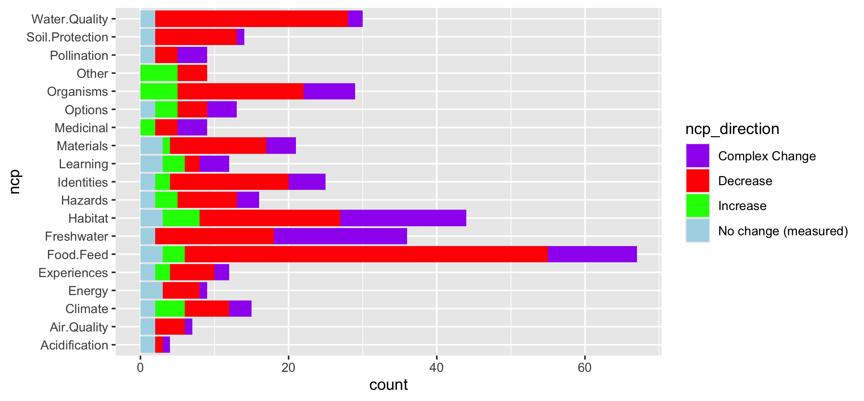
Fix labels

Slide 42
Do by flow type

Slide 43
Fix labels

Slide 44
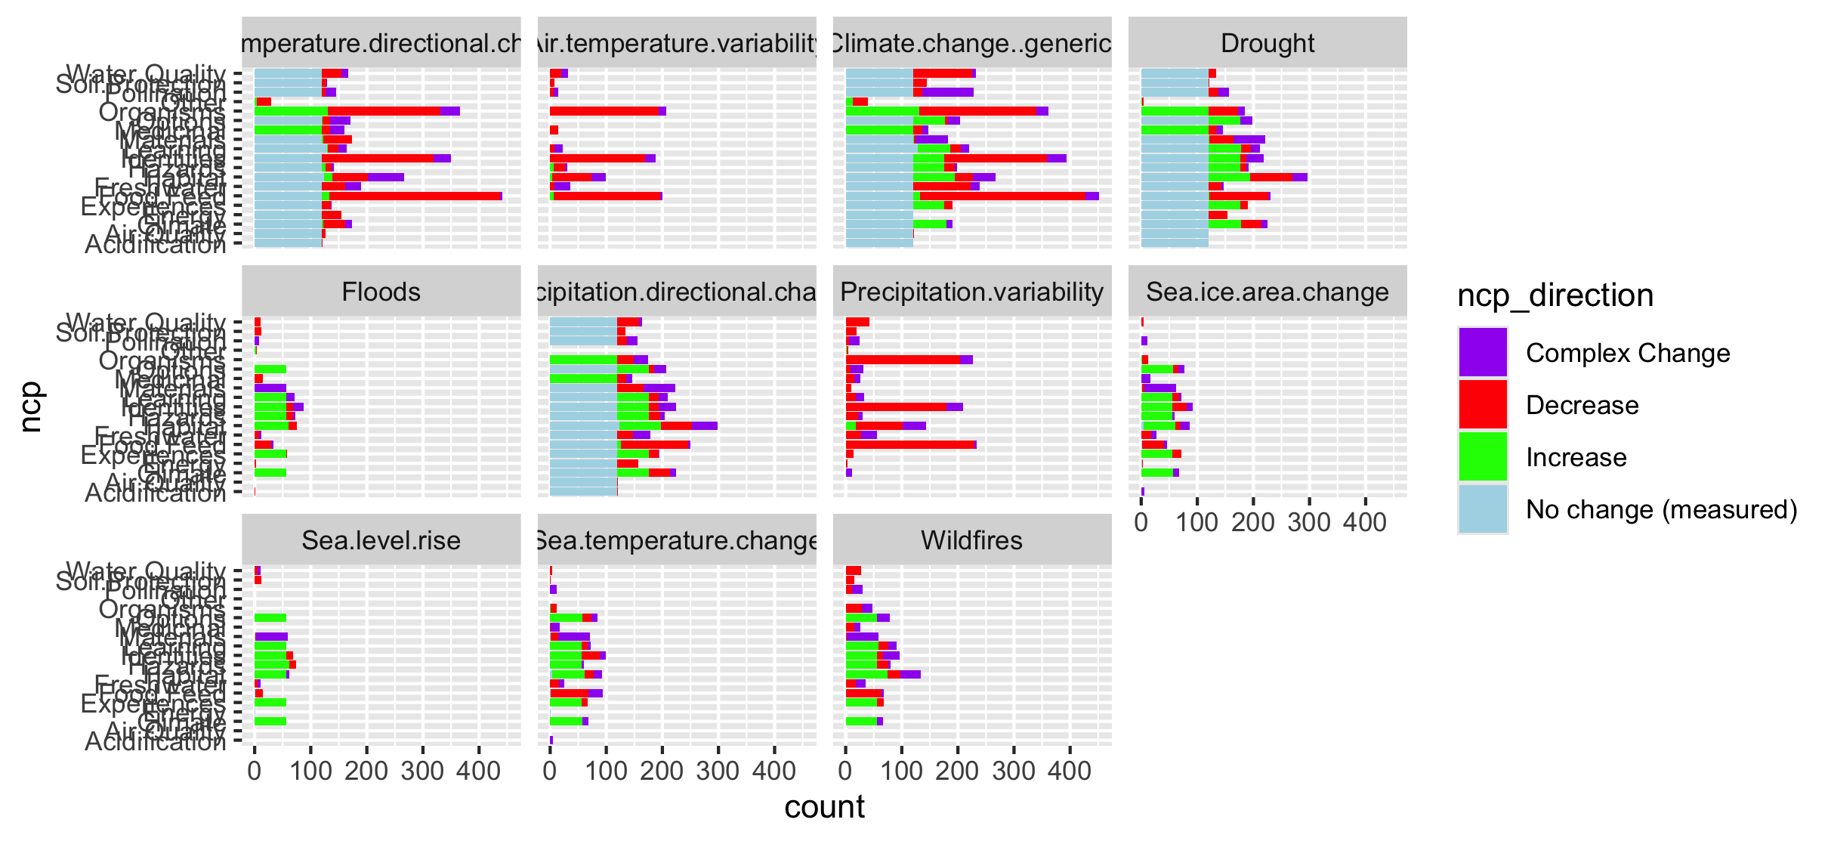

Slide 45
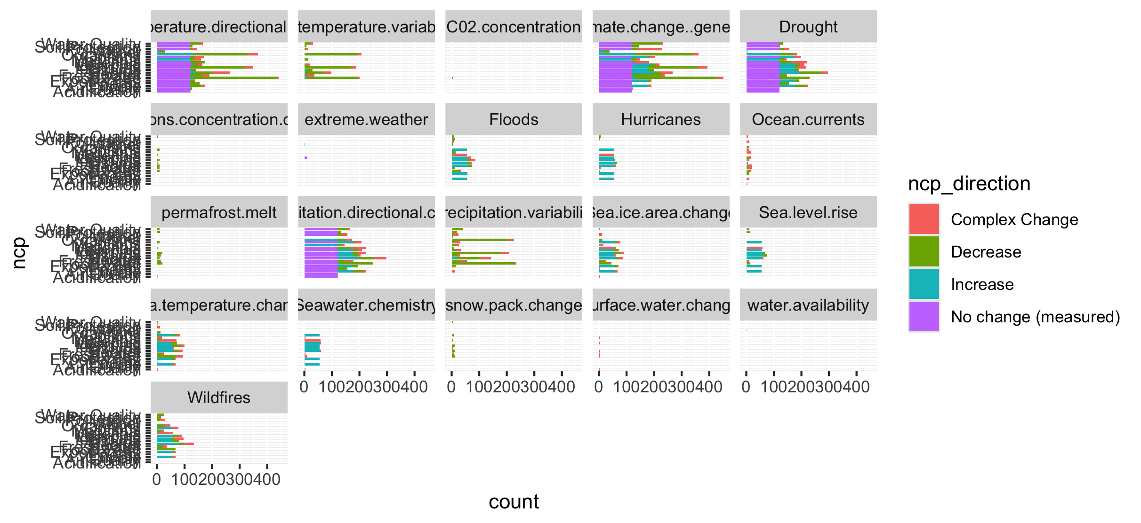
Too many drivers

Slide 46
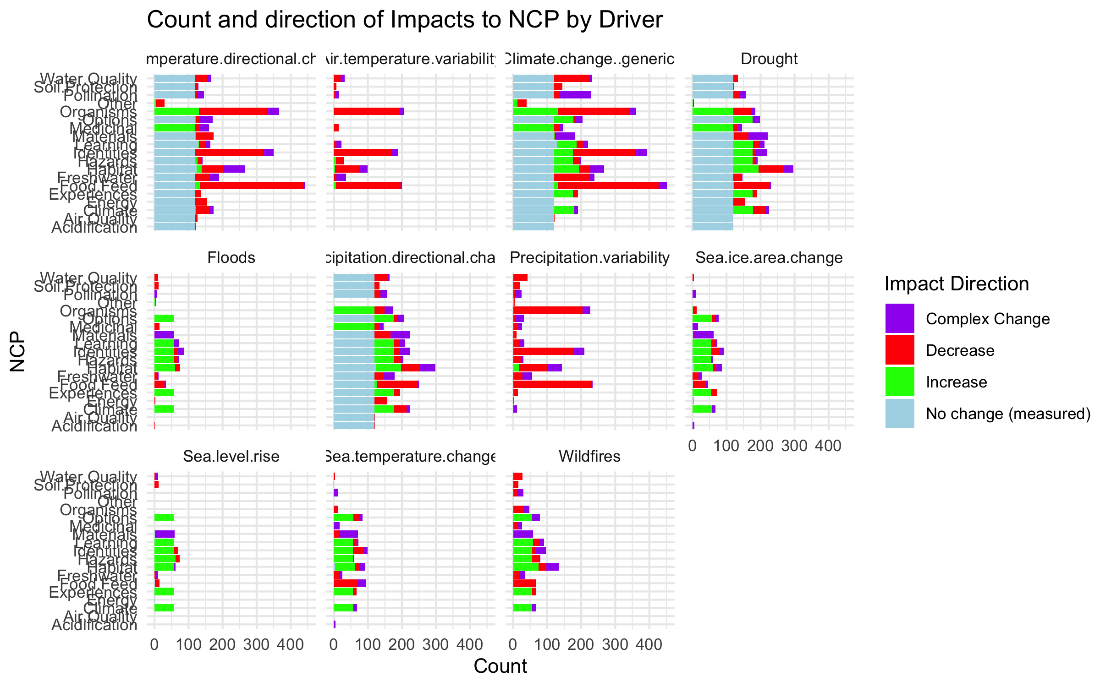

Slide 47
HWB

Slide 48
Connections – how does altered flow relate
Driver~ altered flow (by flow, and subflow – grouped out by flow
Altered flow~ impact (for each category)

